Slide 1
Ensembled- Based and Hybrid Recommendation System

Slide 2
revision………..
Collaborative methods use the ratings of a community of users in order to make recommendations, whereas content-based methods use the ratings of a single user in conjunction with attribute-centric item descriptions to make recommendations.
Knowledge-based methods require the explicit specification of user requirements to make recommendations, and they do not require any historical ratings at all. Therefore, these methods use different sources of data, and they have different strengths and weaknesses.
For example, knowledge-based systems can address cold-start issues much better than either content-based or collaborative systems because they do not require ratings. On the other hand, they are weaker than content-based and collaborative systems in terms of using persistent personalization from historical data. If a different user enters the same requirements and data in a knowledge based interactive interface, she might obtain exactly the same result.

Slide 3
Ensembled- Based and Hybrid Recommendation System
All these models seem rather restrictive in isolation, especially when multiple sources of data are available. In general, one would like to make use of all the knowledge available in different data sources and also use the algorithmic power of various recommender systems to make robust inferences. Hybrid recommender systems have been designed to explore these possibilities. There are three primary ways of creating hybrid recommender systems:
1. Ensemble design
2. Monolithic design
3. Mixed systems

Slide 4
Ensemble design
Ensemble design: In this design, results from off-the-shelf algorithms are combined into a single and more robust output. For example, one might combine the rating outputs from a content-based and a collaborative recommender into a single output. A significant variation exists in terms of the specific methodologies used for the combination process. The basic principle at work is not very different from the design of ensemble methods in many data mining applications such as clustering, classification, and outlier analysis

Slide 5
Ensemble design can be formalized as follows.
Let Rˆ k be an m×n matrix containing the predictions of the m users for the n items by the kth algorithm, where k ∈ {1 ...q}.
Therefore, a total of q different algorithms are used to arrive at these predictions. The (u, j)th entry of Rˆ k contains the predicted rating of user u for item j by the kth algorithm.
Note that the observed entries of the original ratings matrix R are replicated in each Rˆ k, and only the unobserved entries of R vary in different Rˆ k because of the different predictions of different algorithms. The final result of the algorithm is obtained by combining the predictions Rˆ1 ... Rˆq into a single output. This combination can be performed in various ways, such as the computation of the weighted average of the various predictions. Furthermore, in some sequential ensemble algorithms, the prediction Rˆ k may depend on the results of the previous component Rˆ k−1. In yet other cases, the outputs may not be directly combined. Rather, the output of one system is used as an input to the next as a set of content features. The common characteristics of all these systems are that (a) they use existing recommenders in off-the-shelf fashion, and (b) they produce a unified score or ranking.

Slide 6
Monolithic design
A clear distinction may sometimes not exist between the various parts (e.g., content and collaborative) of the algorithm. In other cases, existing collaborative or content-based recommendation algorithms may need to be modified to be used within the overall approach, even when there are clear distinctions between the content-based and collaborative stages. Therefore, this approach tends to integrate the various data sources more tightly, and one cannot easily view individual components as off-the-shelf black-boxes.

Slide 7
Mixed systems
Like ensembles, these systems use multiple recommendation algorithms as black-boxes, but the items recommended by the various systems are presented together side by side

Slide 8
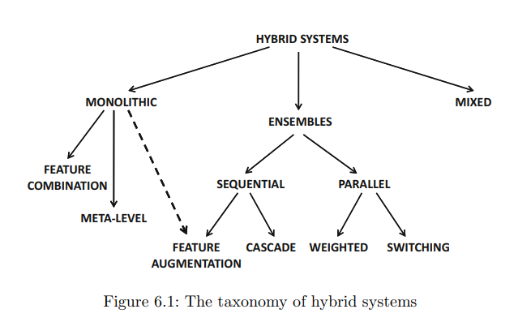

Slide 9
Weighted: In this case, the scores of several recommender systems are combined into a single unified score by computing the weighted aggregates of the scores from individual ensemble components. The methodology for weighting the components may be heuristic, or it might use formal statistical models.
2. Switching: The algorithm switches between various recommender systems depending on current needs. For example, in earlier phases, one might use a knowledge-based recommender system to avoid cold-start issues. In later phases, when more ratings are available, one might use a content-based or collaborative recommender. Alternatively, the system might adaptively select the specific recommender that provides the most accurate recommendation at a given point in time

Slide 10
3. Cascade: In this case, one recommender system refines the recommendations given by another. In generalized forms of cascades, such as boosting, the training process of one recommender system is biased by the output of the previous one, and the overall results are combined into a single output.
4. Feature augmentation: The output of one recommender system is used to create input features for the next. While the cascade hybrid successively refines the recommendations of the previous system, the feature augmentation approach treats then as features as input for the next system

Slide 11
5. Feature combination: In this case, the features from different data sources are combined and used in the context of a single recommender system. This approach can be viewed as a monolithic system, and therefore it is not an ensemble method.
6. Meta level: The collaborative system is modified to use the content features to determine peer groups. Then, the ratings matrix is used in conjunction with this peer group to make predictions. Note that this approach needs to modify the collaborative system to use a content matrix for finding peer groups, although the final predictions are still performed with the ratings matrix. Therefore, the collaborative system needs to be modified, and one cannot use it in an off-the-shelf fashion. This makes the meta-level approach a monolithic system rather than an ensemble system. Some of these methods are also referred to as “collaboration via content” because of the way in which they combine collaborative and content information

Slide 12
Mixed: It does not explicitly combine the scores . Furthermore, this approach is often used when the recommendation is a composite entity in which multiple items can be recommended as a related set.On the one hand, it does use other recommenders as black-boxes (like ensembles), but it does not combine the predicted ratings of the same item from different recommenders. Therefore, mixed recommenders cannot be viewed either as monolithic or ensemble based methods and are classified into a distinct category of their own. The approach is most relevant in complex item domains, and it is often used in conjunction with knowledge-based recommender systems

Slide 13
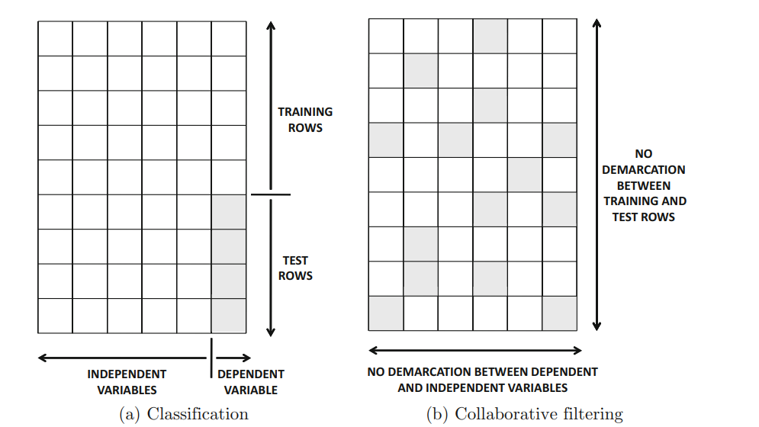

Slide 14
Ensemble Methods from the Classification Perspective
Ensemble methods are commonly used in the field of data classification to improve the robustness of learning algorithms. As we will discuss below, much of this theory also applies to various forms of recommender systems.
For example, content-based recommender systems are often straightforward applications of text classification algorithms. Therefore, a direct application of existing ensemble methods in classification is usually sufficient to obtain high-quality results.
Repeated experiments have shown that combining multiple collaborative recommender systems often leads to more accurate results

Slide 15
This is because the bias-variance theory, which is designed for classification, also applies to the collaborative filtering scenario.

Slide 16
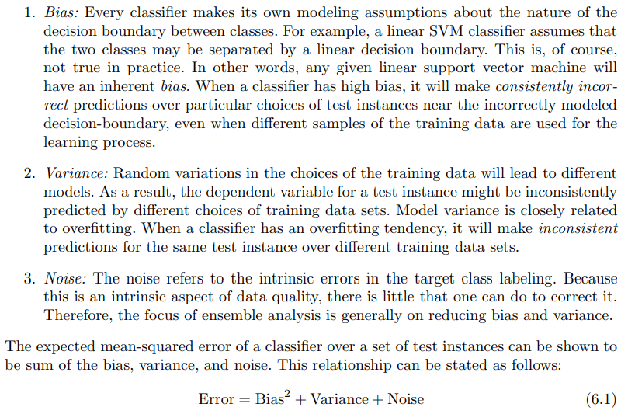

Slide 17
It is noteworthy that by reducing either the bias or variance components, one can reduce the overall error of a classifier. For example, classification ensemble methods such as bagging reduce the variance, whereas methods such as boosting can reduce the bias.
It is noteworthy that the only difference between classification and collaborative filtering is that missing entries can occur in any column rather than only in the class variable.
Nevertheless, the bias-variance result still holds when applied to the problem of predicting a specific column, whether the other columns are incompletely specified or not.
This means that the basic principles of ensemble analysis in classification are also valid for collaborative filtering. Indeed, as we will see later in this chapter, many classical ensemble methods in classification, such as bagging and boosting, have also been adapted to collaborative filtering.

Slide 18
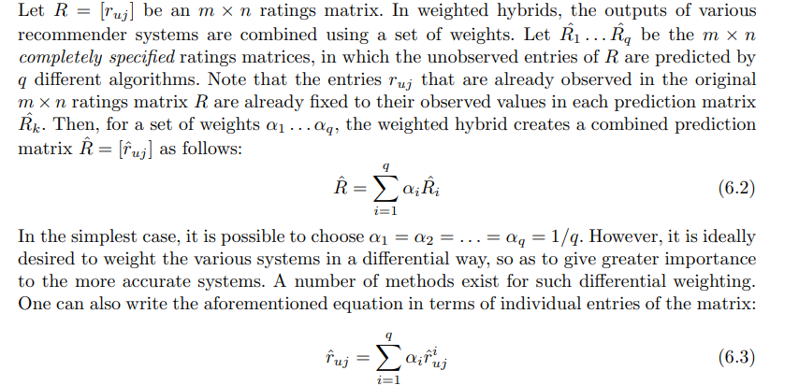
Weighted Hybrids

Slide 19
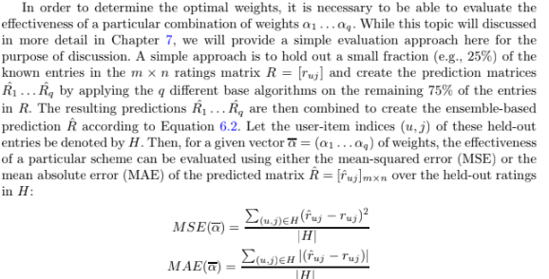

Slide 20
The linear regression approach is, however, sensitive to presence of noise and outliers.
This is because the squared error function is overly influenced by the largest errors in the
data. A variety of robust regression methods are available, which are more resistant to the
presence of noise and outliers. One such method uses the mean absolute error (MAE) as
the objective function as opposed to the mean-squared error. The MAE is well known to be
more robust to noise and outliers because it does not overemphasize large errors.

Slide 21
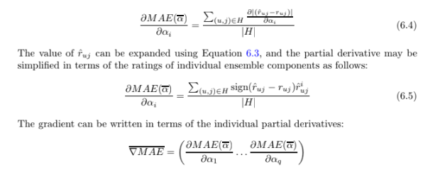

Slide 22
This gradient is then used to descend through the parameter space α with an iterative
gradient descent approach as follows:
1. Initialize α(0) = (1/q . . . 1/q) and t = 0.
2. Iterative Step 1: Update α(t+1) ⇐ α(t) − γ · ∇MAE. The value of γ > 0 can be
determined using a line search so that the maximum improvement in MAE is achieved.
3. Iterative Step 2: Update the iteration index as t ⇐ t + 1.
4. Iterative Step 3 (convergence check): If MAE has improved by at least a mini-
mum amount since the last iteration, then go to iterative step 1.
5. Report α(t)

Slide 23
Regularization can be added to prevent overfitting. It is also possible to add other constraints on the various values of αi such as non-negativity or ensuring that they sum to 1.
Such natural constraints improve generalizability to unseen entries. The gradient descent equations can be modified relatively easily to respect these constraints. After the optimal
weights have been determined, all ensemble models are retrained on the entire ratings matrix without any held-out entries. The predictions of these models are combined with the use of the weight vector discovered by the iterative approach.

Slide 24
Various Types of Model Combinations
1. Homogeneous data type and model classes:In this case, different models are applied on the same data. For example, one might apply various collaborative filtering engines such as neighborhood-based methods, SVD, and Bayes techniques on a ratings matrix. The results are then aggregated into a single predicted value.
2. Heterogeneous data type and model classes: In this cases, different classes of models are applied to different data sources. For example, one component of the model might be a collaborative recommender that uses a ratings matrix, whereas another component of the model might be a content-based recommender. This approach essentially fuses the power of multiple data sources into the combination process.

Slide 25
Adapting Bagging from Classification
bias-variance trade-of - common weighted combination techniques used in the classification problem is that of bagging
the bagging approach needs to be slightly modified in order to adjust for the fact that the collaborative filtering problem is formulated somewhat differently from that of classification
The basic idea in bagging is to reduce the variance component of the error in classification. In bagging, q training data sets are created with bootstrapped sampling. In bootstrapped sampling, rows of the data matrix are sampled with replacement in order to create a new training data set of the same size as the original training data set

Slide 26
A total of q training models are created with each of the sampled training data sets. For a given test instance, the average prediction from these q models is reported. Bagging generally improves the classification accuracy because it reduces the variance component of the error. A particular variant of bagging, known as subagging , subsamples the rows, rather than sampling with replacement. For example, one can simply use all the distinct rows in a bootstrapped sample for training the models. The bagging and subagging methods can be generalized to collaborative filtering as follows:

Slide 27
1. Row-wise bootstrapping: In this case, the rows of the ratings matrix R are sampled with replacement to create a new ratings matrix of the same dimensions. A total of q such ratings matrices R1 ...Rq are thus created An existing collaborative filtering algorithm (e.g., latent factor model) is then applied to each of the q training data sets . For each training data set, an item rating can be predicted for a user only if that user is represented at least once in the matrix.
The predicted rating is then averaged over all the ensemble components in which that user is present. Note that for reasonably large values of q, each user will typically be present in at least one ensemble component with a high probability value of 1 − (1/e)q. Therefore, all users will be represented with high probability.

Slide 28
2. Row-wise subsampling: This approach is similar to row-wise bootstrapping, except that the rows are sampled without replacement. The fraction f of rows sampled is chosen randomly from (0.1, 0.5). The number of ensemble components q should be significantly greater than 10 to ensure that all rows are represented. The main problem with this approach is that it is difficult to predict all the entries in this setting, and therefore one has to average over a smaller number of components. Therefore, the benefits of variance reduction are not fully achieved.

Slide 29
3. Entry-wise bagging: In this case, the entries of the original ratings matrix are sampled with replacement to create the q different ratings matrices R1 ...Rq. Because many entries may be sampled repeatedly, the entries are now associated with weights. Therefore, a base collaborative filtering algorithm is required that can handle entries with weights

Slide 30
4. Entry-wise subsampling: In entry-wise subsampling, a fraction of the entries are retained at random from the ratings matrix R to create a sampled training data set. Typically, a value of f is sampled from (0.1, 0.5), and then a fraction f of the entries in the original ratings matrix are randomly chosen and retained. This approach is repeated to create q training data sets R1 ...Rq. Thus, each user and each item is represented in each subsampled matrix, but the number of specified entries in the subsampled matrix is smaller than that in the original training data. A collaborative filtering algorithm (e.g., latent factor model) is applied to each ratings matrix to create a predicted matrix. The final prediction is the simple average of these q different predictions.

Slide 31
In general, it is desirable to use uncorrelated base models with low bias and high variance in order to extract the maximum benefit from bagging. In cases where bagging does not work because of high correlations across base predictors, it may be helpful to explicitly use randomness injection.

Slide 32
Randomness Injection
Randomness injection is an approach that shares many principles of random forests in classification [22]. The basic idea is to take a base classifier and explicitly inject randomness into the classifier. Various methods can be used for injecting the randomness.

Slide 33
1. Injecting randomness into a neighborhood model: Instead of using the top-k nearest neighbors (users or items) in a user-based or item-based neighborhood model, the top-α · k neighbors are selected for α 1. Then, k elements are randomly selected from these α · k neighbors. This approach can, however, be shown to be an indirect variant of row-wise subsampling at factor 1/α. The average prediction from the various components is returned by the approach.

Slide 34
2. Injecting randomness into a matrix factorization model: Matrix factorization methods are inherently randomized methods because they perform gradient descent over the solution space after randomly initializing the factor matrices. Therefore, by choosing different initializations, different solutions are often obtained. The combinations of these different solutions often provide more accurate results.
It is noteworthy that the bagging approach does not work very well in the case of the factorized neighborhood model.

Slide 35
Switching Hybrids
Switching hybrids are used most commonly in recommender systems in the context of the problem of model selection, but they are often not formally recognized as hybrid systems. The original motivation for switching systems [117] was to handle the cold-start problem, where a particular model works better in earlier stages when there is a paucity of available data. However, in later stages, a different model is more effective, and therefore one switches to the more effective model.

Slide 36
Switching Mechanisms for Cold-Start Issues
One might use a knowledge-based recommender, when few ratings are available because knowledge-based recommender systems can function without any ratings, and they are dependent on user specifications of their needs. However, as more ratings become available, one might switch to a collaborative recommender. One can also combine content based and collaborative recommenders in this way, because content-based recommenders can work well for new items, whereas collaborative recommenders cannot effectively give recommendations for new items

Slide 37
Switching Mechanisms for Cold-Start Issues examples
Eg : First, a nearest neighbor content classifier is used, followed by a collaborative system, and finally a naive Bayes content classifier is used to match with the long-term profile. This approach does not fully address the cold-start problem because all the underlying learners need some amount of data.
Eg : Another work [659] combines hybrid versions of collaborative and knowledge-based systems. The knowledge-based system provides more accurate results during the cold-start phase, whereas the collaborative system provides more accurate results in later stages. Incorporating knowledge-based systems is generally more desirable for handling the coldstart problem.

Slide 38
2. Bucket-of-Models
The held-out entries are then used to evaluate the effectiveness of the model in terms of a standard measure, such as the MSE or the MAE. The model that yields the lowest MSE or MAE is used as the relevant one. This approach is also commonly used for parameter tuning. For example, each model may correspond to a different value of the parameter of the algorithm, and the value providing the best result is selected as the relevant one. Once the relevant model has been selected, it is retrained on the entire ratings matrix, and the results are reported. Instead of using a hold-out approach, a different technique known as cross-validation is also used

Slide 39
Cascade Hybrids
Here, we take a broader view of cascade hybrids in which a recommender is allowed to use recommendations of the previous recommender in any way (beyond just direct refinement), and then combine the results to make the final recommendation. This broader definition encompasses larger classes of important hybrids, such as boosting, which would not otherwise be included in any of the categories of hybrids. Correspondingly, we define two different categories of cascade recommenders.

Slide 40
1 Successive Refinement of Recommendations
In this approach, a recommender system successively refines the output of recommendations from the previous iteration. For example, the first recommender can provide a rough ranking and also eliminate many of the potential items. The second level of recommendation then uses this rough ranking to further refine it and break ties. The resulting ranking is presented to the user
The first knowledge-based recommender is clearly of higher priority because the second-level recommender cannot change the recommendations made at the first level. The other observation is that the second level recommender is much more efficient because it needs to focus only on the ties within each bucket. Therefore, the item-space of each application of the second recommender is much smaller.

Slide 41
2. Boosting
Boosting has been used popularly in the context of classification and regression . One of the earliest methods for boosting was the AdaBoost algorithm. The regression variant of this algorithm is referred to as AdaBoost.RT . The regression variant is more relevant to collaborative filtering because it easier to treat ratings as numeric attributes. In traditional boosting, a sequence of training rounds is used with weighted training examples.

Slide 42
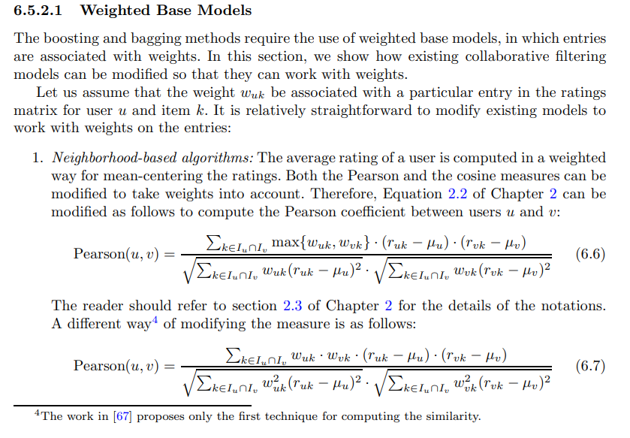

Slide 43
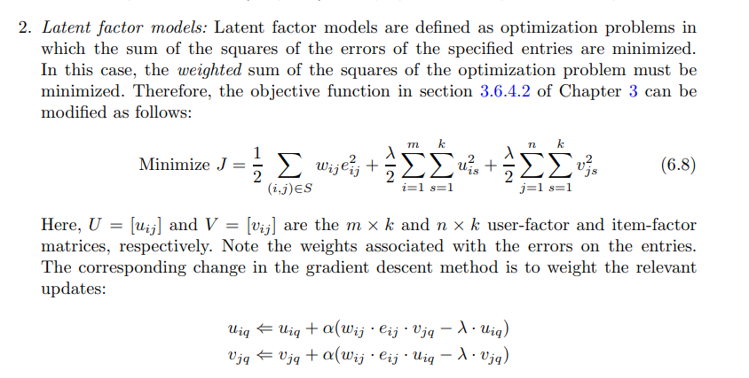

Slide 44
Many other base collaborative filtering algorithms can be modified to work with weighted entries. These types of weighted base algorithms are useful for many collaborative filtering ensembles, such as boosting and bagging.

Slide 45
Feature Augmentation Hybrids
The Libra system combines Amazon.com’s recommender system with its own Bayes classifier. The approach uses the “related authors” and “related titles” that Amazon generates as features describing the items. Note that Amazon generates these recommendations with the use of a collaborative recommender system. These data are then used in conjunction with a content-based recommender to make the final predictions. Note that any off-the-shelf content-based system can be used in principle, and therefore the approach can be viewed as an ensemble system. The approach in opts for a naive Bayes text classifier. It was found through experiments that the features generated by Amazon’s collaborative system were of high quality, and they contributed significantly to better quality recommendations.

Slide 46
Instead of using a collaborative system first, it is also possible to use the content-based system first. The basic idea is to use the content-based system to fill in the missing entries of the ratings matrix so that it is no longer sparse. Thus, the missing entries are estimated by the content-based system to create a denser ratings matrix. These newly added ratings are referred to as pseudo-ratings. Then, a collaborative recommender is used on the dense ratings matrix to make rating predictions. Finally, the collaborative prediction is combined.

Slide 47
How can such weights be determined? The weight of a pseudo-rating intuitively represents the algorithm’s certainty in the prediction of the first phase, and it is an increasing function of the number of ratings |Ii| of that user. A number of heuristic functions are used to weight various ratings, and the reader is referred to for details. Note that this approach requires modifications to the second phase of collaborative filtering, and off-the-shelf algorithms cannot be used. Such methods can be viewed as monolithic systems.

Slide 48
Meta-Level Hybrids
before, one can robustly compute the similarities between users with this new representation. The main idea here is that the content-based peer group is used to determine the most similar users of the target user. Once the peer group has been determined, then the weighted average of the ratings of the peer group are used to determine the predicted ratings. Note that this approach does require a certain amount of change to the original collaborative recommender, at least in terms of how the similarity is computed.
Furthermore, the first phase of the approach cannot use off-the-shelf content-based models in their entirety because it is mostly a feature selection (preprocessing) phase. Therefore, in many cases, these systems cannot be considered true ensembles, because they do not use existing methods as off-the-shelf recommenders.

Slide 49
Another example of a meta-level system was LaboUr in which an instance-based model is to used to learn the content-based user’s profile. The profiles are then compared using a collaborative approach. These models are compared across users to make predictions. Many of these methods fall within the category of “collaboration via content,” though that is not the only way in which such hybrids can be constructed.

Slide 50
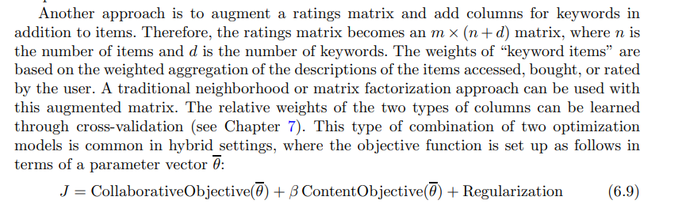
Feature Combination Hybrids
Regression and Matrix Factorization
Regression and Matrix Factorization
Meta-level Features

Slide 51
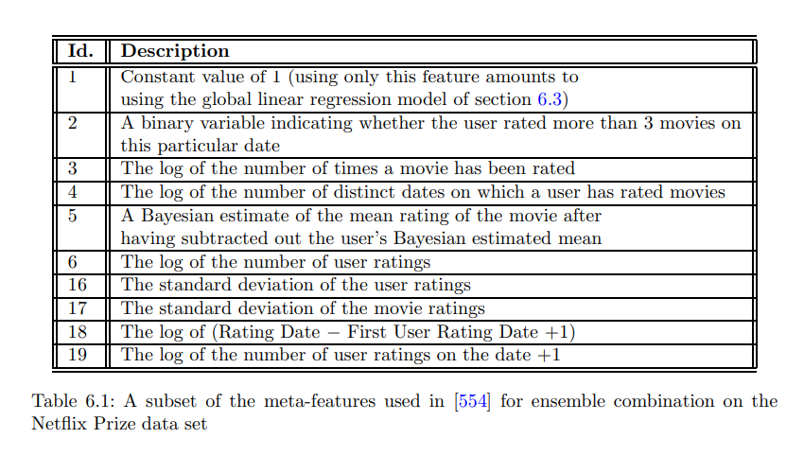

Slide 52
Mixed Hybrids
The main characteristic of mixed recommender systems is that they combine the scores from different components in terms of presentation, rather than in terms of combining the predicted scores. In many cases, the recommended items are presented next to one another. Therefore, the main distinguishing characteristic of such systems is the combination of presentation rather than the combination of predicted scores.

Slide 53
example of a mixed hybrid has been proposed in the tourism domain. In this case, bundles of recommendations are created, where each bundle contains multiple categories of items.
For example, in a tourism recommender system, the different categories may correspond to accommodations, leisure activities, air-tickets, and so on.
Tourists will typically buy bundles of these items from various categories in order to create their trips.
For each category, a different recommender system is employed.
The basic idea here is that the recommender system that is most appropriate for obtaining the best accommodations, may not be the one that is most appropriate for recommending tourism activities.
Therefore, each of these different aspects is treated as a different category for which a different recommender system is employed.
Furthermore, it is important to recommend bundles in which the items from multiple categories are not mutually inconsistent.
For example, if a tourist is recommended a leisure activity that is very far away from her place of accommodation, then the overall recommendation bundle will not be very convenient for the tourist.

Slide 54
Therefore, a knowledge base containing a set of domain constraints is incorporated for the bundling process. The constraints are designed to resolve inconsistencies in the product domain. A constraint satisfaction problem is employed to determine a mutually consistent bundle.
It is noteworthy that many of the mixed hybrids are often used in conjunction with knowledge-based recommender systems as one of the components . This is not a coincidence. Mixed hybrids are generally designed for complex product domains with multiple components like knowledge-based recommender systems.

